Slide 1
Managing project and Teams
Lecture 7: Risk Management

Slide 2
Retrospection
Managing Project Scope
Managing Project Quality
Managing Project Responsibility
Notes:
Managing project scope, quality, and responsibility are critical components of project management, ensuring that projects are delivered successfully, meet stakeholder expectations, and achieve their intended outcomes.

Slide 3




Project Risk

Slide 4
Key topics covered in this lecture

Slide 5
What we will cover in this lecture
By the end of the lesson, students should be able to:
Define risk and risk management
Describe risk management steps
Impact of risks in projects and teams
Factors to consider for controlling risks

Slide 6
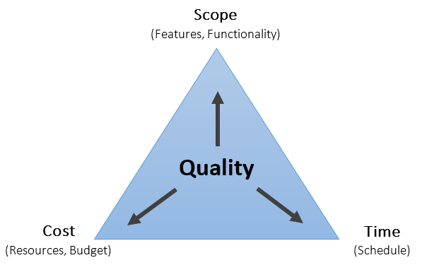
Constraint Triangle
Notes:
Time and Scope: You can reduce your project scope to also reduce your project duration if you’re running behind schedule.
Cost and Scope: By reducing the project scope, you’ll need to execute fewer tasks, which means lower costs.
Cost and Time: In some projects, time and cost can be directly related.

Slide 7
Introduction
Risk – an uncertain event or condition that, if it occurs, has a positive or negative effect on a project.
Risk is commonly defined as a measure of the probability and severity of adverse effects.
Risk in software projects is usually defined as the probability-weighted impact of an event on a project (Bannerman, 2008).
According to Bannerman (2008),
R= P x I
where P= s the probability the undesirable event will be realized
I is the impact or magnitude of the loss if the event occurs.
Risk is a danger, hazard or threat of a poor outcome.

Slide 8

Is understanding risk in software project and teams necessary.? Why?
ⓘ Start presenting to display the poll results on this slide.

Slide 9
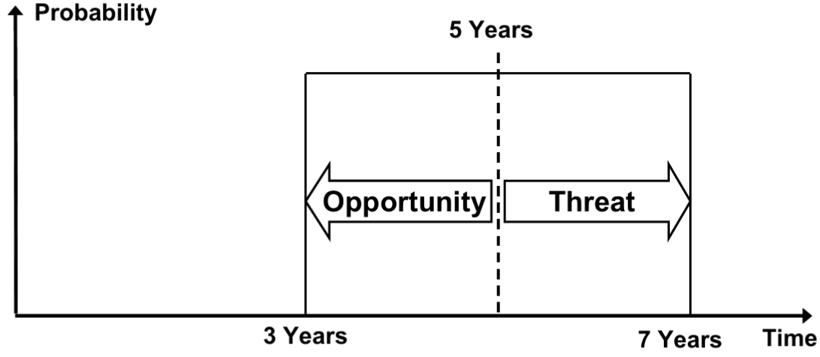
Risk: Threat and Opportunities

Slide 10
History of the emergence of Risk Management
Risk management practices can be traced back to ancient civilizations such as Mesopotamia, where merchants used written contracts to mitigate trading risks.
Corporate failures
Financial Failures
Major safety disasters
Growth of Software Industry (1980s-1990s):
Threats to business continuity
Capability Maturity Model (CMM) and ISO 9000 series, emphasized process improvement and quality management.
Severe reputational damage …………………….
Notes:
Projects became larger and more complex, involving multiple stakeholders and increased uncertainty.
Issues such as cost overruns, schedule delays, and project failures highlighted the need for better risk management practices.

Slide 11


Risks against who/what?
ⓘ Start presenting to display the poll results on this slide.

Slide 12
Classes of Risks
There are mainly 3 classes of risks that may affect a computer code project:
Project Risks - monetary funds, schedules, personnel, resources, and customer-related issues
Technical Risks - concern potential style, implementation, interfacing, testing, and maintenance issues.
Business Risk - risks of building a superb product that nobody needs, losing monetary funds or personal commitments

Slide 13
Risks within a System Context
Notes:
Often the focus is on the symptoms of cost overruns and schedule delays rather than on the root causes in product acquisition and development
Contractual & legal risks
Performance risks
Scalability risks
Security risks
Technical risks

Slide 14
What is risk management ?
Risk Management is about managing threats or minimising the potential harm by implementing strategies and actions to control the risk.
It is about good management:
Managers being aware of what could stop them achieving their objectives
Leadership recognising potential exceptional / unexpected events that could disrupt activities
To be effective, risk management should be at the forefront of daily business and decision making
Risk management is a systematic approach to identify, assess, and understand risk in order to guide further appropriate management decisions and actions.
Notes:
To minimize the potential harm of a risk event by implementing strategies and actions to control and reduce risk

Slide 15
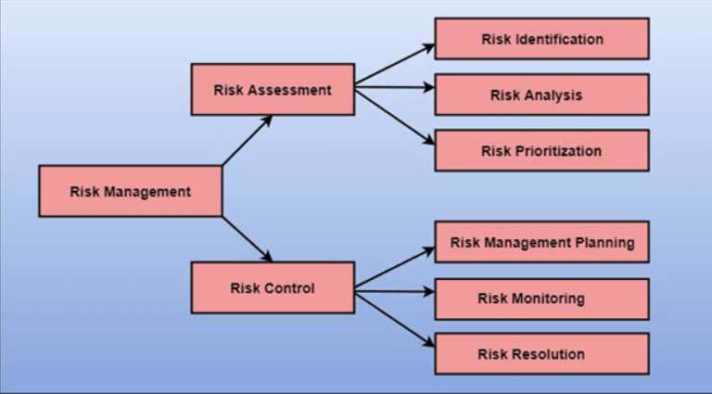
Risk Management Activities

Slide 16
Five Always Risk Activities
Integration
Data migration
Customisation
Unproven technology/unproven team
Too large projects

Slide 17
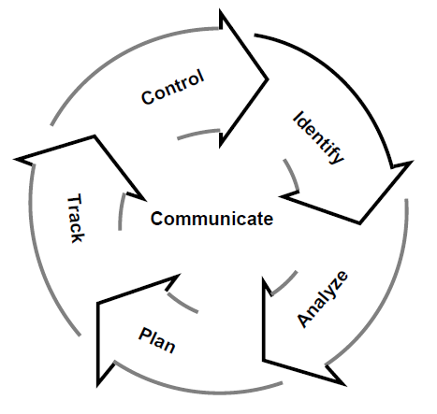
Risk Management Processes
Risk identification – what are the risks to a project?
Risk analysis – which ones are really serious?
Risk planning – what shall we do?
Risk track – has the risk been tracked?
Risk control
Notes:
Risks that are not identified will not be managed.

Slide 18
Risk identification
Approaches to identifying risks include:
Use of checklists – usually based on the experience of past projects
Brainstorming – getting knowledgeable stakeholders together to pool concerns
Causal mapping – identifying possible chains of cause and effect
History

Slide 19
Risk Identification
Product size—risks associated with the overall size of the software to be built.
Business impact—risks associated with constraints imposed by management or the marketplace.
Customer characteristics—risks associated with the sophistication of the customer and the developer's ability to communicate with the customer in a timely manner.
Process definition—the degree to which the software process has been defined and is followed by the development organization.
Development environment—risks associated with the availability and quality of the tools to be used to build the product.
Technology to be built—risks associated with the complexity of the technology.
Staff size and experience—risks associated with the overall technical and project experience of the software engineers who will do the work.

Slide 20
Assessing Project Risk-I
Have top software and customer managers formally committed to support the project?
Are end-users enthusiastically committed to the project and the system/product to be built?
Are requirements fully understood by the software engineering team and their customers?
Have customers been involved fully in the definition of requirements?
Do end-users have realistic expectations?

Slide 21
Assessing Project Risk-II
Is project scope stable?
Does the software engineering team have the right mix of skills?
Are project requirements stable?
Does the project team have experience with the technology to be implemented?
Is the number of people on the project team adequate to do the job?
Do all customer/user constituencies agree on the importance of the project and on the requirements for the system/product to be built?

Slide 22
Risk Components
Performance risk—the degree of uncertainty that the product will meet its requirements and be fit for its intended use.
Cost risk—the degree of uncertainty that the project budget will be maintained.
Support risk—the degree of uncertainty that the resultant software will be easy to correct, adapt, and enhance.
Schedule risk—the degree of uncertainty that the project schedule will be maintained and that the product will be delivered on time.

Slide 23
Risk Projection
Risk projection, also called risk estimation,
attempts to rate each risk in two ways
the likelihood or probability that the risk is real
the consequences of the problems associated with the risk, should it occur.
The are four risk projection steps:
establish a scale that reflects the perceived likelihood of a risk
delineate the consequences of the risk
estimate the impact of the risk on the project and the product,
note the overall accuracy of the risk projection so that there will be no misunderstandings.

Slide 24











Building a Risk Table

Slide 25
Building the Risk Table
Estimate the probability of occurrence
Estimate the impact on the project on a scale of 1 to 5, where
1 = low impact on project success
5 = catastrophic impact on project success
sort the table by probability and impact

Slide 26
Risk Analysis
During the risk analysis process, you have to consider every identified risk and make a perception of the probability and seriousness of that risk.

Slide 27
Risk Occurrence
Unknown Unknowns
Known Knowns
Known Unknowns
Notes:
Unknown Unknowns-These risks are unknown to the organization and are generally technology related risk due to this these risks are not anticipated.
Known Knowns- These are risks that are well-understood and documented by the team. E.g The shortage of developers is a known risk that can cause delays in software development.
Known Unknowns- the organization is aware of potential risks, but the certainty of their occurrence is uncertain.

Slide 28

Management and Perception
Risk management is influenced by what is perceived to be risky.
Risk perception guides opinions on risk and risk management
Perception depends on past experiences, preparedness, perceived control, etc.
Notes:
Before we can go any further on risk management, it is very important to acknowledge risk perception. To “perceive” means to experience and become aware of, and our “perception” is our interpretation of our experiences. How we manage our risk is directly determined by our perception of the risk. It is the perception of risk that guides our opinions on the level of risk and our subsequent decision-making about how it should be managed. A simple example: if we don’t perceive a hazard to be risky, we will not need to manage it.
What does this perception depend on?
Some of these factors are past experiences, current levels of preparedness, perceived control, culture, and many more.

Slide 29
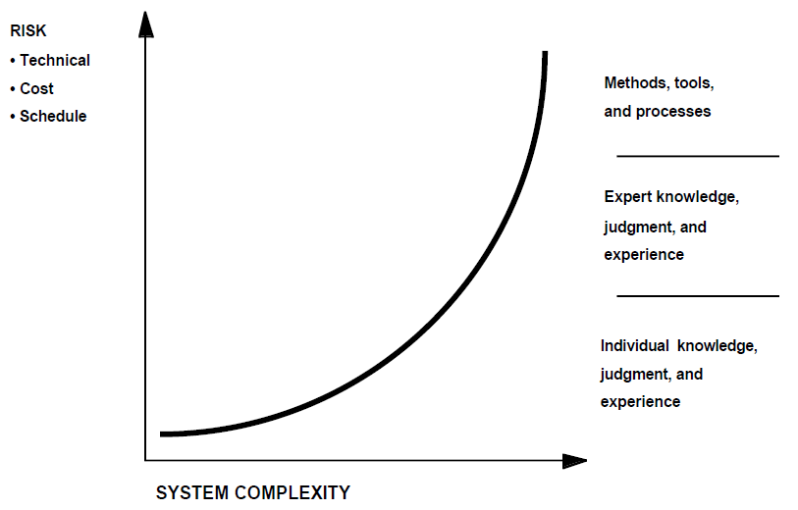
Manage Risk Increases With System Complexity
Manage Risk Increases With System Complexity

Slide 30
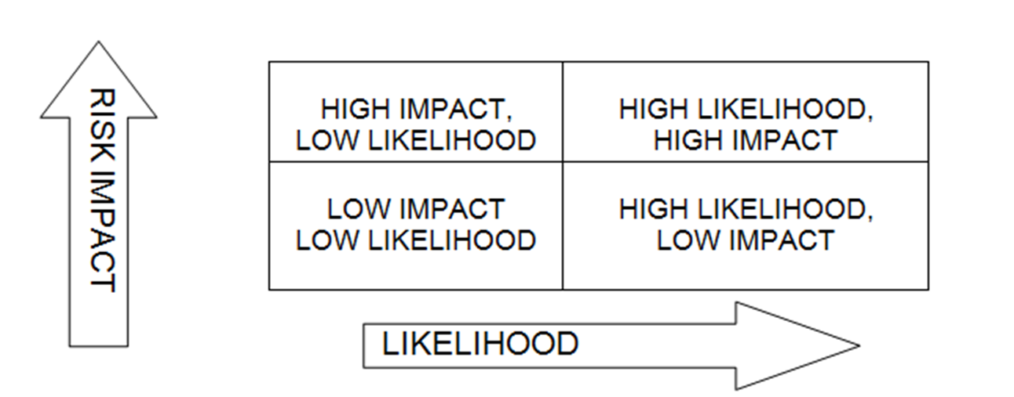
CLASSIFICATION OF RISKS

Slide 31
Prioritising risk
Risk Impact = High if 50% or higher , Low if 49% or lower
Likelihood = High is 50% or higher , Low if 49% or lower
HIGH RISK = high impact on project. May cause a lot of damage to project. E.G. Time delay, workers not returning, materials lost, going over budget.
MEDIUM RISK = not definite it will happen, the possibility is there. E.G. Given workers time off, could affect schedule, financial implications.
LOW RISK= it has a very low chance of occurring. Risks that are easy to fix. E.G. Workers using long lunch breaks all the time.

Slide 32
Risk Prioritisation
Risk exposure (RE) = (potential damage) x (probability of occurrence)
Ideally Potential damage: a money value e.g. a flood would cause £0.5 millions of damage Probability 0.00 (absolutely no chance) to 1.00 (absolutely certain) e.g. 0.01 (one in hundred chance) RE = £0.5m x 0.01 = £5,000
Crudely analogous to the amount needed for an insurance premium

Slide 33
Risk Control
Risk Avoidance
Risk Transfer
Risk reduction
Risk Acceptance
Risk Sharing
Scenario Analysis
Notes:
Risk Avoidance - Example: Choosing not to use a particular technology known for its instability in a critical system.
Risk Transfer - Purchasing liability insurance to mitigate financial risks associated with potential legal actions.
Risk Reduction - Conducting thorough testing and quality assurance procedures to reduce the likelihood of software defects.
Risk Acceptance - Deciding not to invest additional resources in mitigating a low-impact risk with a low probability of occurrence.
Risk Sharing - Forming partnerships with suppliers to share supply chain risks and ensure continuity of operations
Scenario Analysis - Simulating various market conditions to understand the potential impact of economic risks on a product launch.

Slide 34
Reactive Risk Management
Project team reacts to risks when they occur
Mitigation—plan for additional resources in anticipation of fire fighting
Mix on failure—resource are found and applied when the risk strikes
Crisis management—failure does not respond to applied resources and project is in jeopardy

Slide 35
Proactive Risk Management
formal risk analysis is performed
organization corrects the root causes of risk
Total Quality Management (TQM) concepts and statistical Software Quality Assurance
examining risk sources that lie beyond the bounds of the software
developing the skill to manage change
Notes:
Statistical Software Quality Assurance (SQA) is a specific aspect of TQM that focuses on using statistical techniques to ensure the quality of software products.

Slide 36
Methodological Framework for Software Risk Management (SRM)
Software Capability Maturity Model (SW-CMMSM)
Software Acquisition-Capability Maturity Model (SA-CMMSM)
Project Management Institute (PMI) Risk Management Framework
The Capability Maturity Model Integration (CMMI)
Projects IN Controlled Environments (PRINCE2) Risk Management
Notes:
The SW-CMMSM provides software organizations with guidance on how to gain control of their process for developing and maintaining software and how to evolve toward a culture of software engineering excellence.
SA-CMM describes five levels of organizational software acquisition maturity
CMMI provides guidelines for identifying, analyzing, and mitigating risks throughout the software development lifecycle.
PRINCE2 (Projects IN Controlled Environments) is a project management methodology that includes specific processes for risk management.

Slide 37
Process to monitor & control risk?
Track and monitor identified risks
Evaluate risk response plans that are put into action as a result of risk events
Monitor the project for risk triggers. There may be additional risk triggers
Ensure that policies and procedures are followed. These must be clear to all stakeholders
Update schedule and cost reserves. The updated schedule and cost reserves depend on the decisions taken

Slide 38
Risk Mitigation, Monitoring, and Management
mitigation—how can we avoid the risk?
monitoring—what factors can we track that will enable us to determine if the risk is becoming more or less likely?
management—what contingency plans do we have if the risk becomes a reality?

Slide 39
Discussion
Risk Due to Business Impact
Risk Due to Product Size
Risks Due to the Customer
Risks Due to Process Maturity

Slide 40
Risk Management Culture
Project team is a social group.
An indicator of weak risk management culture is compliance with the mechanics of the process being achieved in a box-ticking manner.
The influence of risk management culture is reflected in the Risk Maturity Model (RMM) weightings structure.
Key Question- Do people involved with the project understand and use their freedom to act?

Slide 41
Risk Management Culture (Cont’d)
In a dysfunctional team, lack of clarity can cause team members to avoid responsibility for risks.
delegation of responsibility without the necessary resources or decision making powers. This leads to the disempowerment of managers at lower levels in the management hierarchy.
Professional culture based on open communication.
A culture of planning rather than doing.
Engaging a project director in the process

Slide 42
Ethical consideration in Risk disclosure
Honesty and Integrity
Full Disclosure
Respect for Stakeholders
Informed Consent
Confidentiality and Privacy
Transparency and Accountability
Cultural Sensitivity
Notes:
Ethical risk disclosure requires honesty and integrity in representing potential risks associated with a product, service, or decision.
Ethical practice necessitates providing comprehensive and accurate information about known risks, including their nature, severity, and potential impact.
Ethical risk disclosure should consider cultural differences and sensitivities when communicating risks to diverse stakeholders
Ethical risk disclosure is fundamental to building and maintaining trust, fostering transparency, and promoting responsible decision-making in organizations and society. B

Slide 43
Discussion
Risk analysis is a crucial component of software project management, but it often involves a balance between thoroughness and efficiency. How do you strike the right balance in conducting risk analysis for a software project, ensuring that potential risks are adequately identified and addressed without overly delaying project progress?
Discuss strategies for balancing thorough risk analysis with project efficiency in software development.

Slide 44
Summary

Slide 45
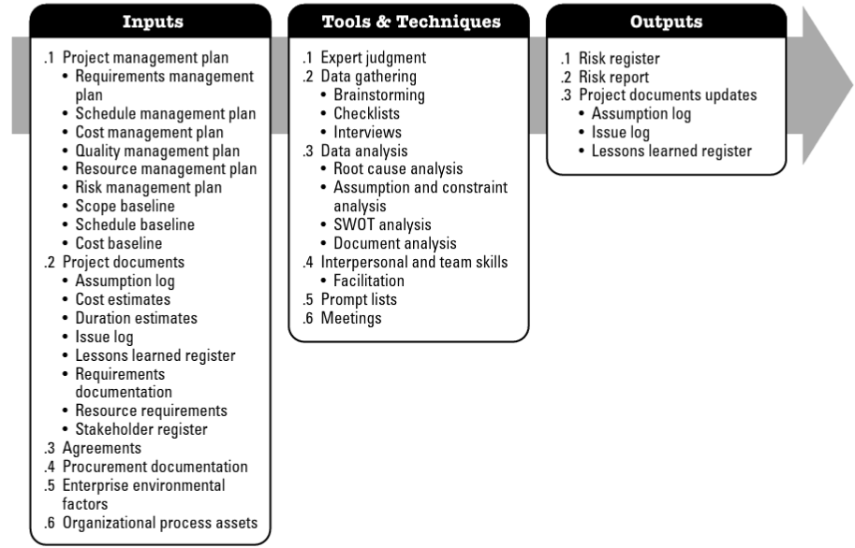
Identify Risks

Slide 46
Key takeaway points
Risk management
Risk identification
Risk analysis and prioritisation
Risk Management Planning
Risk monitoring and resolution

Slide 47
Next Lesson
Project Metrics and Performance Measurement in Teams

Slide 48
References
Bannerman, P.L., 2008. Risk and risk management in software projects: A reassessment. Journal of systems and software, 81(12), pp.2118-2133.
Hopkinson, Martin. The Project Risk Maturity Model : Measuring and Improving Risk Management Capability, Taylor & Francis Group, 2010. ProQuest Ebook Central.
Guide, P.M.B.O.K., (2017). A Guide to the Project Management Body of Knowledge (PMBOK® Guide), Project Management Institute.
Murray, A.P., 2016. The Complete Software Project Manager: Mastering Technology from Planning to Launch and Beyond. John Wiley & Sons.
Verzuh, E., 2015. The fast forward MBA in project management. John Wiley & Sons.
Ward, G.G., 2018. Effective project management: guidance and checklists for engineering and construction. John Wiley & Sons.

